Slide 1
About WebRTC
Presentation

Slide 2
Prepared By
Md. Musarrat Hossain Chowdhury

Slide 3
TABLE OF CONTENTS
1. What is web RTC ?
2. WebRTC Architecture
3. What is a Signalling server?
4. WebRTC APIs
5. GetUserMedia ()
6. RTCPeerConnection()
7. RTC DataChannel()
8. How Connection is established?
9. ICE(Interective Connectivity Establishment)
10.How to scale for millions of users
11.Uses of WebRTC
12.Web RTC alternatives
13.Lackings of Web RTC

Slide 4
What is Web RTC
WebRTC (Web Real-Time Communication) is a new web technology which allows browser and mobile applications with functionalities such as audio/video calling, chat, P2P (peer-to-peer) file sharing and all that without any additional third-party software or plugins.
It was published as an open source technology by Google in May 2011 and includes fundamental components for real-time communication on the web.
WebRTC is also highly secure, as it uses end-to-end encryption to protect data and ensures that only the authorized parties can access it. Additionally, WebRTC is open-source, which means that anyone can access its source code and contribute to its development.
WebRTC is a powerful and versatile technology that has revolutionized real-time communication on the web, and its adoption continues to grow rapidly as more developers discover its capabilities.

Slide 5
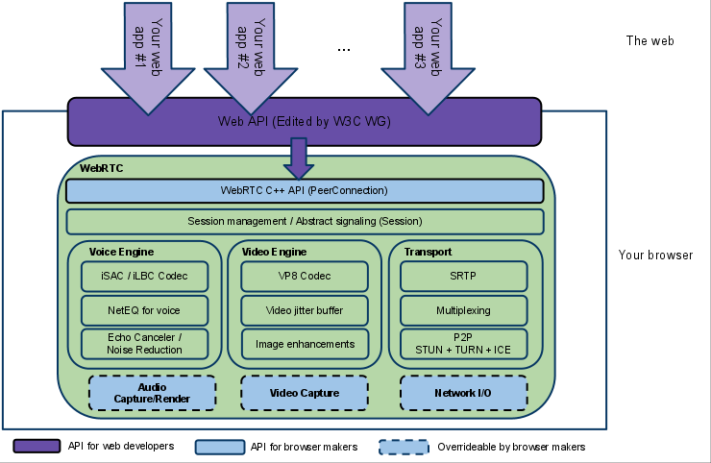
WebRTC Architecture
Fig : 1

Slide 6
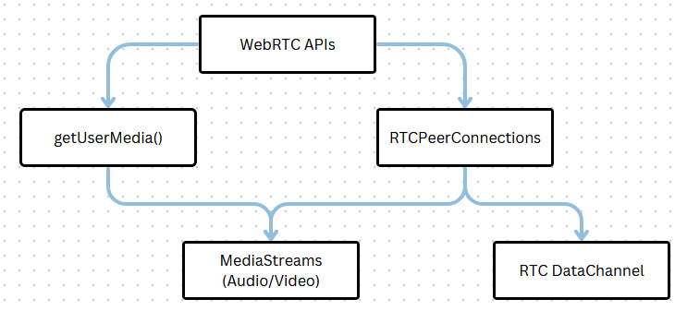
WebRTC APIs
It is important to know that WebRTC is not just a single API , but it is a collection of APIs. And protocols defined by various working groups such as W3C and IETF (Internet Engineering Task Force).
Fig: 2

Slide 7
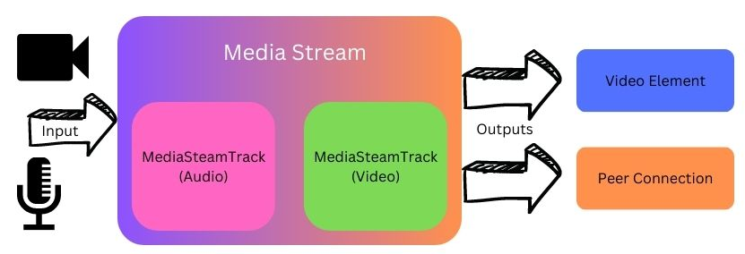
GetUserMedia ()
Provide access to multimedia stream (video, audio or both) from local devices.
Two main components in the MediaStream API are the MediaStream track and MediaStream interface.
Fig:3
MediaStream track represents a type of media that have been obtained from the input source.
The output can be forwarded as video element or PeerConnection.

Slide 8
RTCPeerConnection()
The RTCPeerConnection API represents a WebRTC connection between the local computer and remote peer.
Core part of the WebRTC connection.
It provides methods- connect to a remote peer, maintain and monitor the connection , and close the connection.
This API is responsible for managing the full life cycle of each peer-to-peer connection.

Slide 9
RTC DataChannel()
RTCDataChannel API enables exchange of arbitrary data between two peers.
RTCDataChannel can be configured to provide reliable or unreliable delivery of messages.
RTCDataChannel can be configured to provide in-order or out-of-order delivery of messages.
Reliable and in-order delivery is similar to TCP(Transmission Control Protocol).
Unreliable and out-of-order delivery is similar to UDP( User Diagram Protocol).

Slide 10
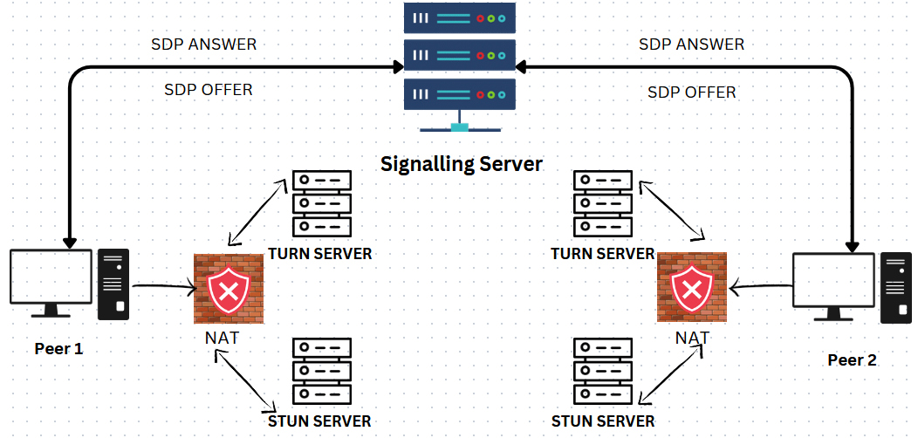
How Connection is established?
Fig : 4

Slide 11

How Connection is established?
SDP Offer And Answer : The first handshake is done through SDP Offer and answer. Peers receives media information about other peers through this exchange.
Discovering IP Address : Now the peers need to know their own IP address and port number. But NAT or firewall makes it difficult.
STUN (Session Traversal Utilities for NAT) :server is used by ICE to determine the public IP address of a peer.
TURN (Traversal Using Relays around NAT) :If STUN server fails, ICE routes the traffic through a TURN (Traversal Using Relays around NAT) server.
Final Step : When the peer receives the response from the STUN server, it extracts its public IP address and port number from the response which is then used to send media streams directly to other peers.

Slide 12
What is a signaling server?
Signalling is the process of setting up, controlling and terminating a communication session between the clients.
To communicate between 2 end point major 3 process needs to happen:
Session control information
Exchange IP address and port related information
Exchange codes and media type of the end user.
These configuration (metadata) are exchange via (Session Description Protocol).
So there should be a server to exchange the user data initially to setup WebRTC connection.
After the signaling process, all the media and data will be exchanges via RTC peerconnection od WebRTC.

Slide 13
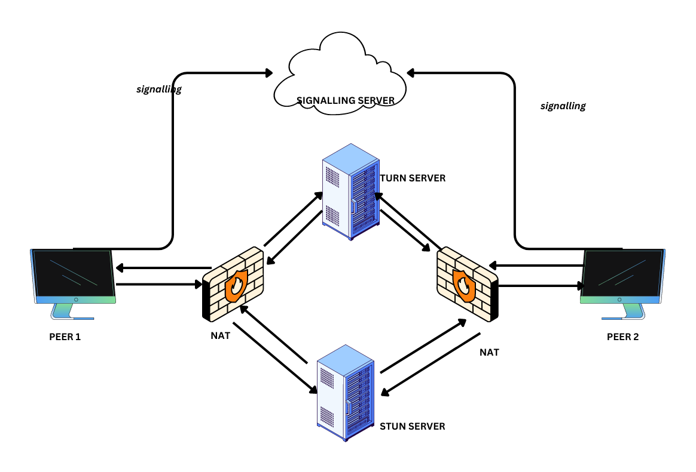
ICE(Interective Connectivity Establishment)
Fig : 5

Slide 14
ICE(Interective Connectivity Establishment)
The internet addressing system is still using IPV4 (Internet Protocol Version 4) and because of that , most of our devices are behind ine or more layers of NAT (Network Address Transmission) NAT is a mechanism of mapping private address to the public addresses to the public addresses changing address information within IP protocols while it is in transmit through the device for routing.
WebRTC technology developers can use ICE which simplifies the complexity of the internet addressing system.
After session description set, ICE agent automatically begains to find all the possible candidate IP, port for local peer.
ICE agent queries the operating system for local IP addresses.
ICE agent queries an external STUN server (id configured) to retrieve the public IP and port.
If configured, ICE agent add the TURN server as a last resort candidate.

Slide 15
How to scale?
To Scale the project for millions of users these modifications can be done :
Use Adaptive Bitrate Streaming : Adaptive bitrate streaming (ABS) adjusts the quality of the media stream in real-time based on the available bandwidth. This can greatly improve the viewing experience for users with slower internet connections, while also reducing the load on the server.
Implement efficient media codecs: Using efficient media codecs, such as H.265 or VP9, can help reduce the size of the media streams while maintaining good quality. This can result in faster loading times and a better overall user experience.
Use a media server: A media server can help distribute the load of handling media streams across multiple servers, which can improve performance and scalability. By using a media server, you can also offload resource-intensive tasks like transcoding and media processing from the client devices.
Optimize media handling: Media handling involves tasks such as transcoding, segmenting, and packaging media streams. You can optimize these processes by using hardware acceleration, optimizing the codec settings, and implementing caching and pre-fetching techniques.

Slide 16
Frame rate: Frame rate is the number of video frames per second. To improve frame rate, you can use efficient video codecs, reduce the resolution of the video, and implement hardware acceleration for video processing.
Latency: Latency is the time it takes for data to travel from one peer to another. To reduce latency, you can use a signaling server that is geographically close to the users, implement a media server with low latency, and optimize the network configuration to minimize packet loss.
Implement horizontal scaling: Horizontal scaling involves adding more servers as needed to handle increasing traffic. You can use load balancers to distribute traffic across multiple servers, which can help improve performance and scalability

Slide 17
Uses of Web RTC
WebRTC can be used in a variety to enable real-time communication and collaboration features. Here are some common uses of WebRTC :
Video conferencing:. Users can join a virtual meeting room and communicate with each other in real-time, with support for high-quality audio and video streams.
Live streaming : Users can broadcast live events, concerts, or webinars, and viewers can join the stream and interact with each other in real-time.
Gaming : Users can play multiplayer games with each other in real-time, with support for low latency and high-quality audio and video streams.
E-learning : Users can attend virtual classes, seminars, or workshops, and interact with each other and the instructor in real-time.
Customer support : Users can join a virtual helpdesk and communicate with customer support agents in real-time, with support for audio, video, and data exchange.

Slide 18
Lackings of Web RTC
Browser Compaitibility: WebRTC is supported by most modern web browsers, but some older browsers may not support all of its features. This can make it difficult to build applications that work across all browsers and devices.
Network Traversal : While STUN and TURN servers can help WebRTC peers to traverse NATs and firewalls, there are still some situations where direct connections may not be possible. This can lead to increased latency and reduced quality of service, particularly in situations where media streams need to be relayed through a TURN server.
Security : WebRTC includes some security features like end-to-end encryption, but there are still some potential security risks associated with using the technology. For example, attackers may be able to intercept or manipulate media streams if they are able to compromise the network infrastructure or exploit vulnerabilities in the WebRTC implementation.

Slide 19
Web RTC alternatives
Web Sockets : WebSockets is a protocol that provides a two-way communication channel between a client and a server. It is often used in real-time web applications for real-time communication.
Socket.io : Socket.io is a JavaScript library that enables real-time, bidirectional and event-based communication between the browser and the server.
Jitsi : itsi is a set of open-source projects that allows for video conferencing and collaboration over the internet. It is similar to WebRTC, but provides additional features such as support for recording and streaming.
Twilio : Twilio is a cloud communications platform that provides APIs for building communication applications. It includes support for voice, video, and messaging, and can be used to build applications similar to WebRTC.

Slide 20
The End

